Slide 1

Advance Webprogrammig
CENTURION UNIVERSITY OF TECHNOLOGY AND MANAGEMENT,
BATCH 2020-24
Notes:
Links:
https://www.pexels.com/photo/people-near-table-3184639/

Slide 2

E-Commerce Website
Teamwork by –: Aditya Kumar Das (200301120144)
–: Soumya Ranjan Nayak (200301120175)
-: P Sudip Kumar Prusty (200301120183)
-:Lalatendu Bidyadhar samal (200301120148)
Guided By -:
Prof. Nilamadhab Dash
Notes:
Links:
https://www.pexels.com/photo/photo-of-people-sitting-near-wooden-table-3183190/

Slide 3

TABLE OF CONTENTS
Introduction
Description
Features
Requirement
Objective
Interface
Policy Implications
Conclusion
This is a text placeholder that you can edit. This is a text placeholder that you can edit. This is a text placeholder that you can edit.
Notes:
Links:
https://www.pexels.com/photo/photo-of-people-near-computers-3183159/

Slide 4
Introduction
Now a days the life style of the people is different. People feel uncomfortable and time consuming for going crowded markets. The online shopping platform helps them to purchase goods and services online by mobile, or computers. Shoppers can visit web stores from the comfort of their house and shop as by sitting in front of the device.
Online stores are usually available 24 hours a day. One of the most enticing factors about online shopping is, particularly during holiday season, it alleviates the need to wait in long lines or search from a store for a particular item. Consumers can get full information about the product with its reviews being passed by the existing users.
Notes:
Links:
https://www.pexels.com/photo/person-in-blue-denim-jacket-sitting-on-chair-while-writing-39866/
https://www.pexels.com/photo/close-up-photography-of-man-wearing-sunglasses-1212984/
https://www.pexels.com/photo/man-wearing-brown-dress-shirt-holding-white-fedora-hat-1036627/
https://www.pexels.com/photo/photo-of-woman-wearing-blue-zip-up-jacket-1090387/

Slide 5


Working Description
Shop 24/7
Comfort of own home
A lot of products with in a click away
Comparison shopping easier
Discount coupons available
Notes:
Links:
https://www.pexels.com/photo/business-businessman-contemporary-corporate-532220/

Slide 6

Features
79%
1. Mobile-Friendly Website
2. High-Resolution Photos of product
3. User-Generated Reviews for the quality of product
4. Special Offers available
5. Related Items
68%
46%
37%
2025
2026
2027
2028
2029
2030

Slide 7
Requirements:
->Hardware Requirement:
Printer, to print the required documents of the project
Compact Drive
Processor : Intel
Ram : 512 MB or more than 512MB
Hard disk : 80 GB or more than 80GB
->Software Requirement:
Operating system : Windows , MacOs or Linux
Programming : Notepad or visual studio code
Formspree
Microsoft PowerPoint

Slide 8
Objective:
->The objectives of online shopping are pre-defined on which the whole system work to achieve them by managing the details of all customers, payments, bills, products, shopping, and so on.
To shop wile within the comfort of your own home, without having to step out of the door
To be able to easily save money and compare prices from website to website
Online resellers tent to sell at a lower price due to less overhead expenses

Slide 9
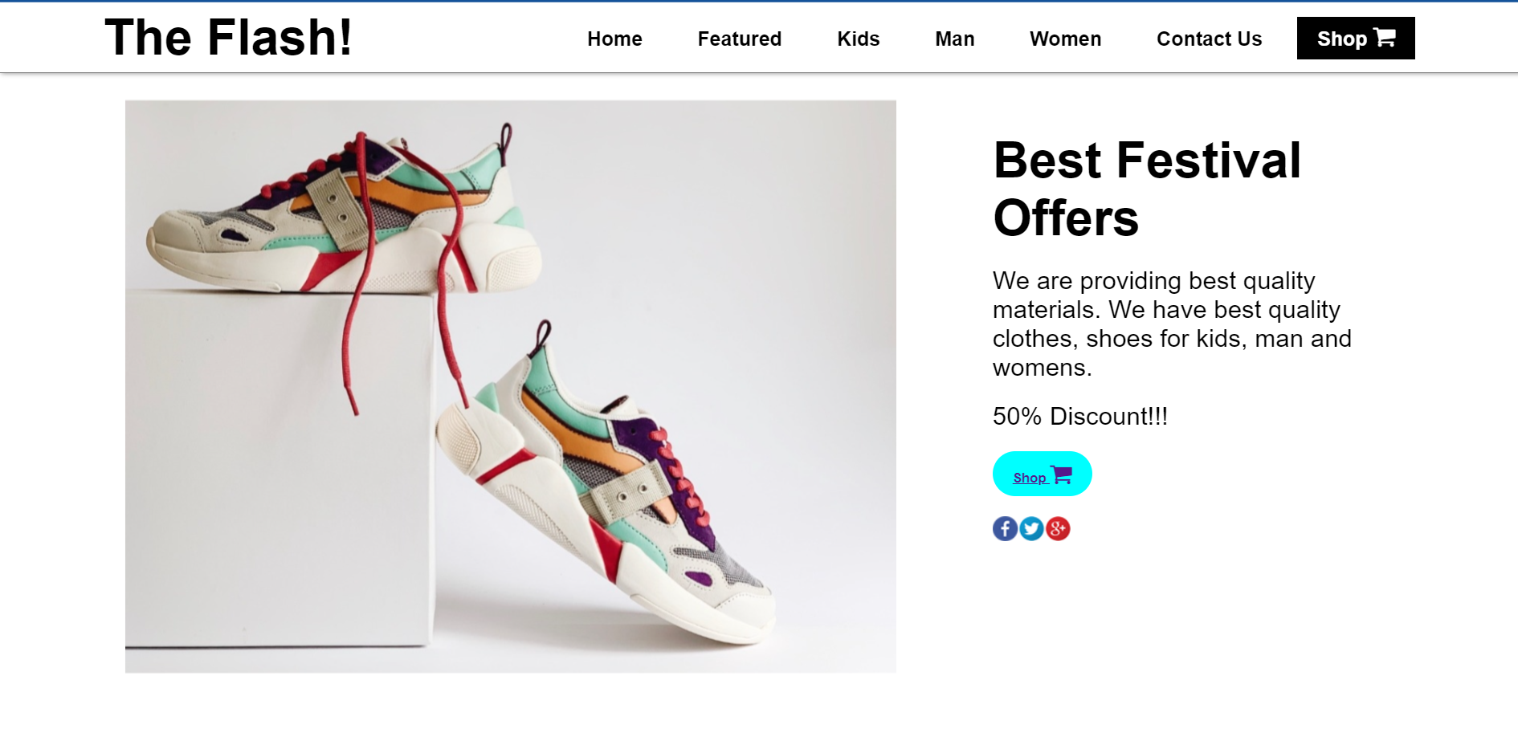
Home Page

Slide 10
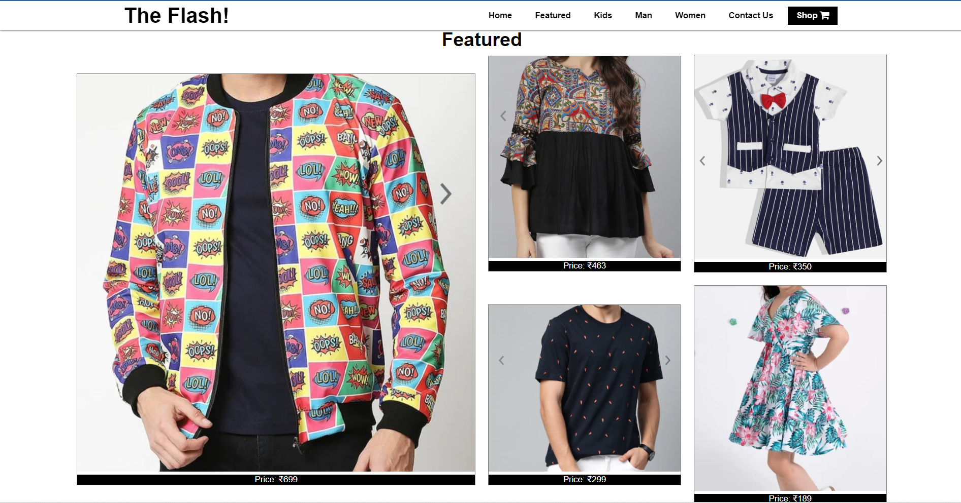
Featured

Slide 11
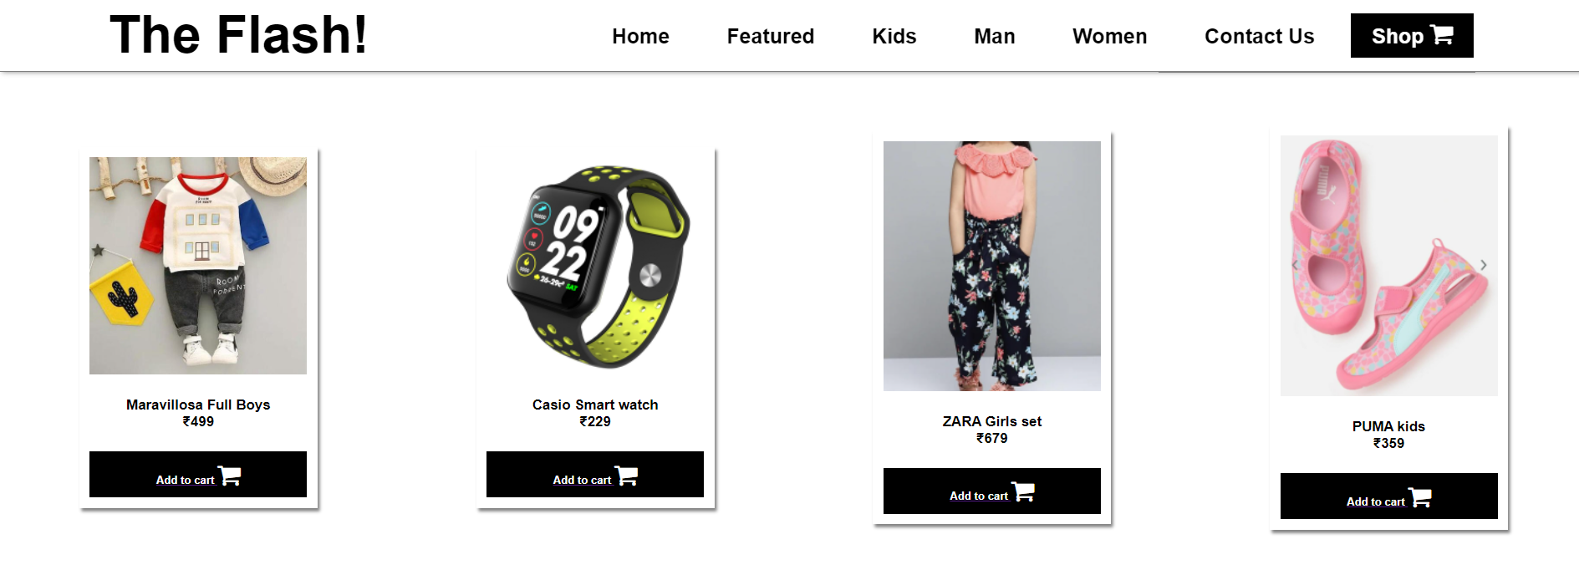
Kids Section

Slide 12
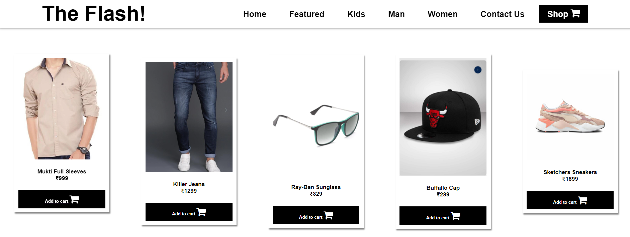
Men’s section

Slide 13
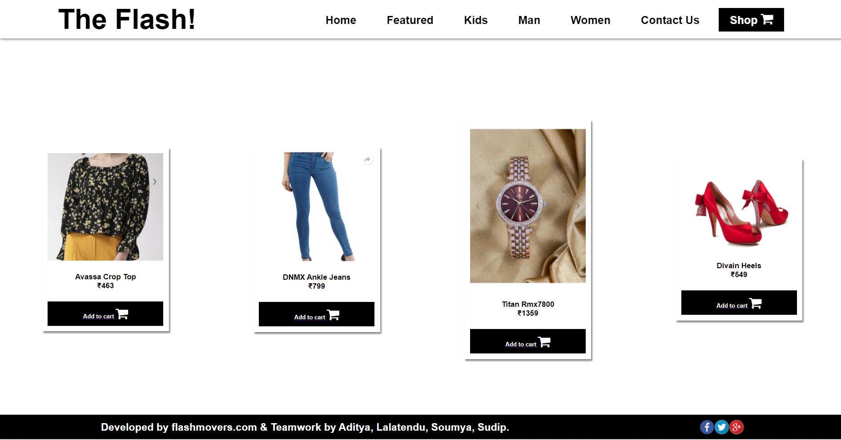
Women’s section

Slide 14
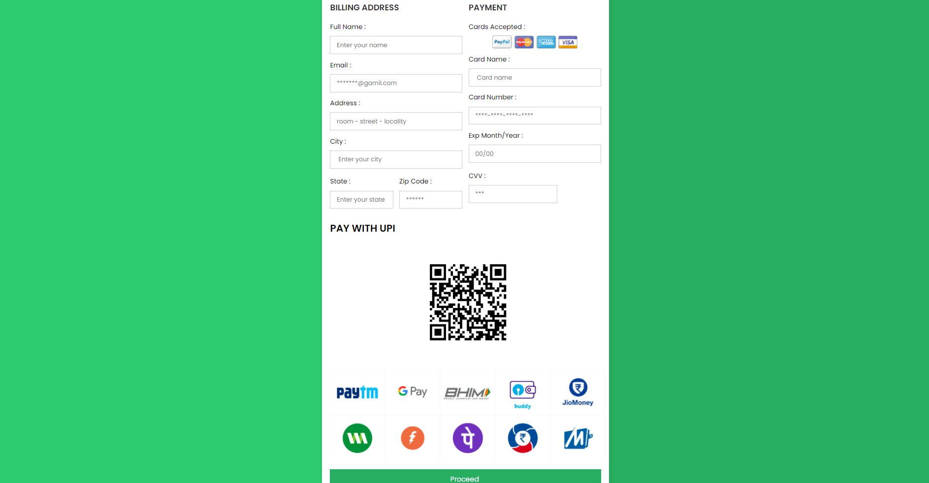
Payment section

Slide 15

Contact us

Slide 16
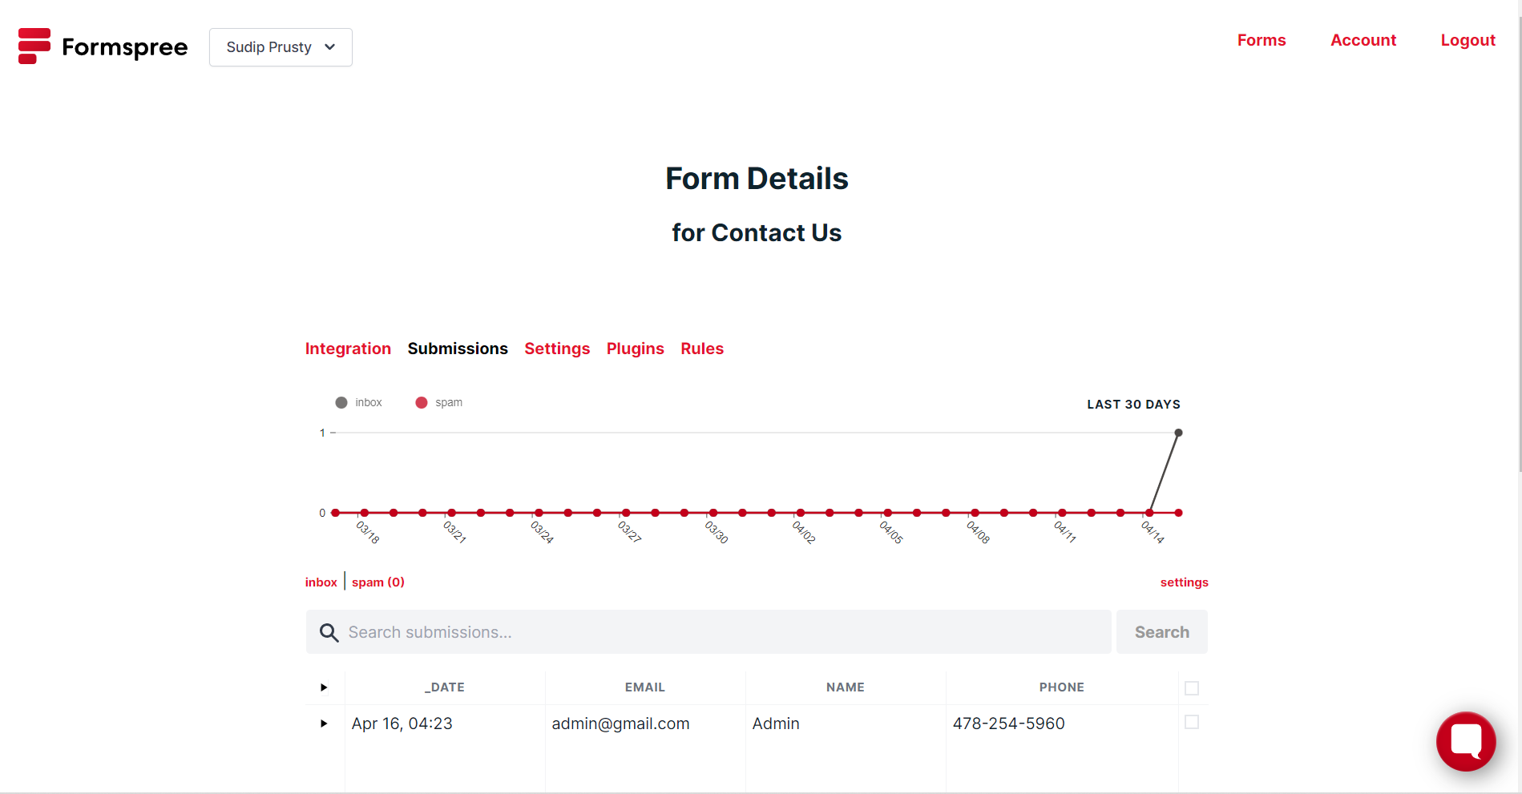
Form Details

Slide 17

POLICY IMPLICATIONS
Online shopping is easy, but it can be made more secure
More Privacy should be implemented
.
Product displayed sometimes differs with the product supplied. It should be improved.
Online Shopping is yet to catch up in our towns. Internet penetration is not enough
Notes:
Links:
https://www.pexels.com/photo/apple-laptop-notebook-office-39284/
https://www.pexels.com/photo/two-imac-s-with-keyboard-and-phones-on-desk-326503/
https://www.pexels.com/photo/photo-of-imac-near-macbook-1029757/

Slide 18

CONCLUSION
E-Commerce has undeniably become an important part of our society. The successful companies of the future will be those that take E-Commerce seriously, dedicating sufficient resources to its development. E-Commerce is not an IT issue but a whole business undertaking.
Companies that use it as a reason for completely re-designing their business processes are likely to reap the greatest benefits. Moreover, E-Commerce is a helpful technology that gives the consumer access to business and companies all over the world.

Slide 19
THANK YOU
Notes:
Links:
https://www.pexels.com/photo/people-near-table-3184639/

